Slide 1
Tourism Customer Sales Analysis
Key Findings and Recommendations
Data In Motion Travel Analytics
Tableau Analysis
Presented by: William Castilla

Slide 2
Executive Summary: Customer purchase performance is influenced by contact type, city tier, pitch satisfaction, occupation, and product type.
Company-invited customers have a higher conversion rate than self-enquiry customers.
Product sales are concentrated primarily in Tier 1 and Tier 3 cities.
Higher pitch satisfaction is generally associated with stronger product purchase rates.
Product purchases are heavily concentrated in the Basic product category, while total monthly income varies substantially across occupations.
Key Metrics: 18.8% Overall Conversion Rate | 920 Products Taken | 4,888 Total Customers | $23,620 Average Monthly Income

Slide 3
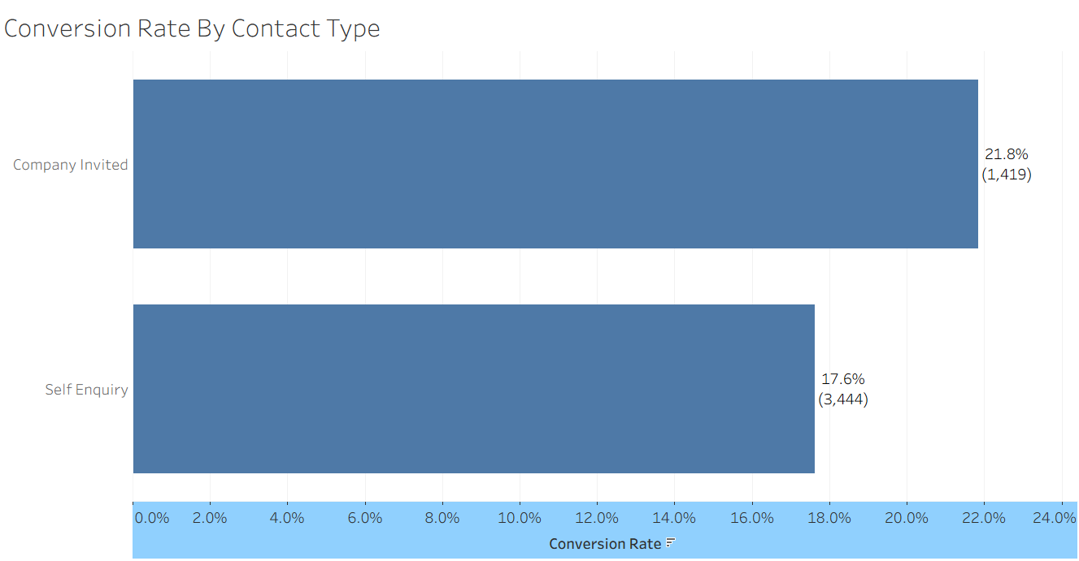
Company-Invited Customers Have a Higher Conversion Rate
Company-Invited customers have a higher conversion rate at 21.8%, compared with 17.6% for self-enquiry customers.

Slide 4
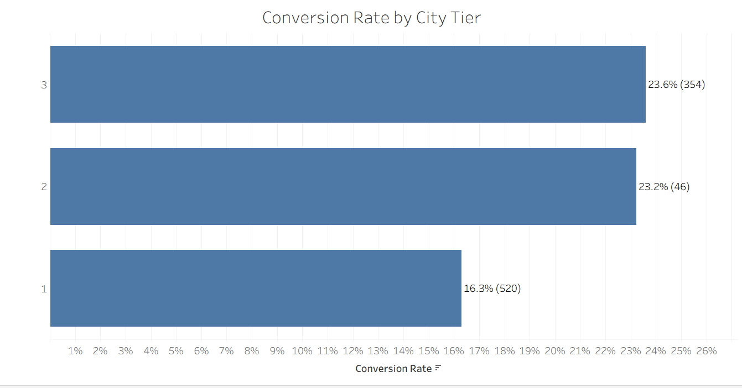
Conversion Rates Vary By City Tier
Tier 3 has the highest conversion rate at 23.6%, followed closely by Tier 2 at 23.2%. Tier 1 has the lowest conversion rate at 16.3%, despite generating the most product purchases.

Slide 5
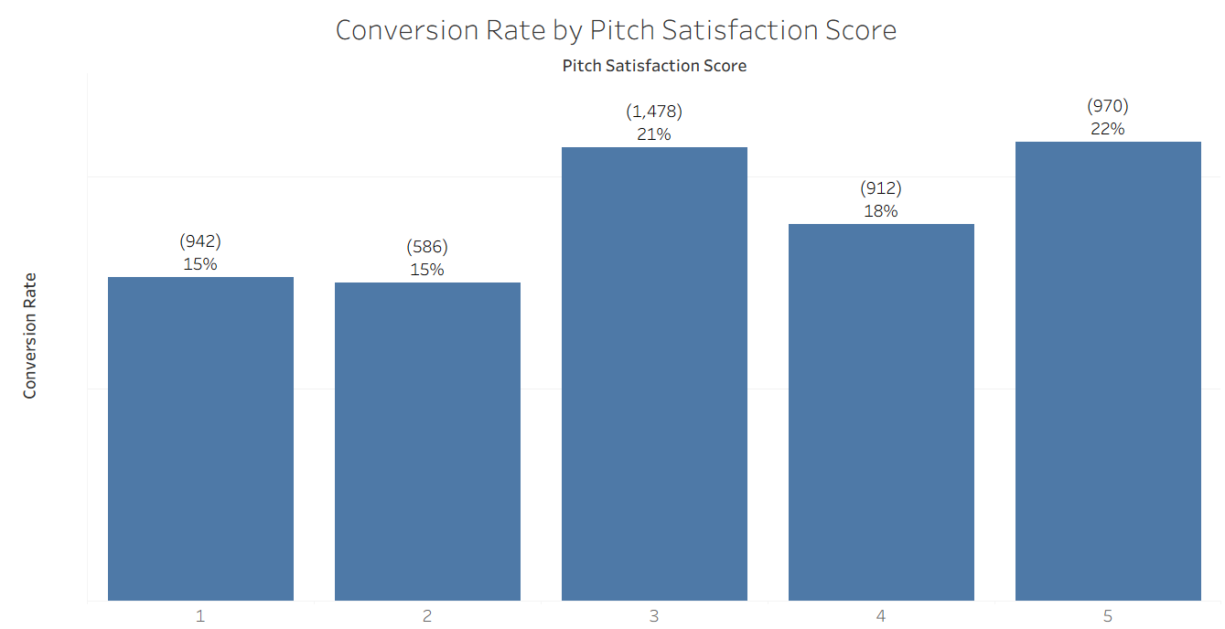
Higher Pitch Satisfaction Is Associated With Higher Conversion Rates
Higher pitch satisfaction is generally associated with higher conversion rates, increasing from 15% at satisfaction levels 1-2 to 21% at level 3 and reaching 22% at level 5.

Slide 6
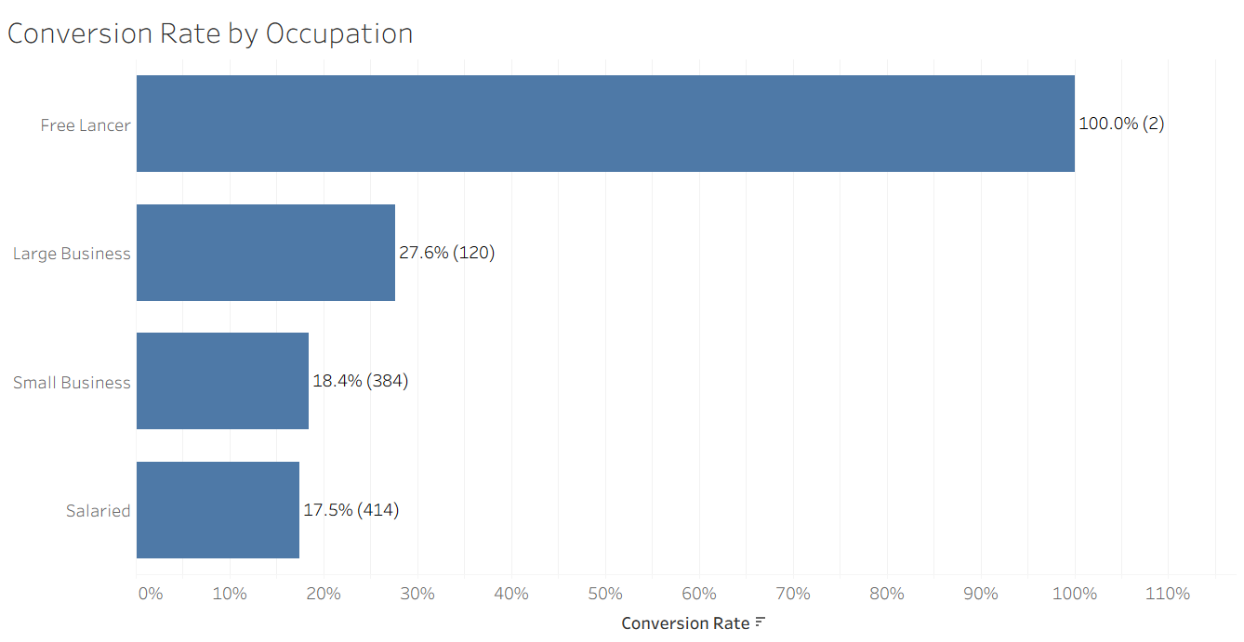
Conversion Rate Varies By Occupation
Conversion rates vary by occupation, with Large Business customers having the highest rate among larger customer groups at 27.6%, followed by Small Business at 18.4%, and Salaried at 17.5%.

Slide 7
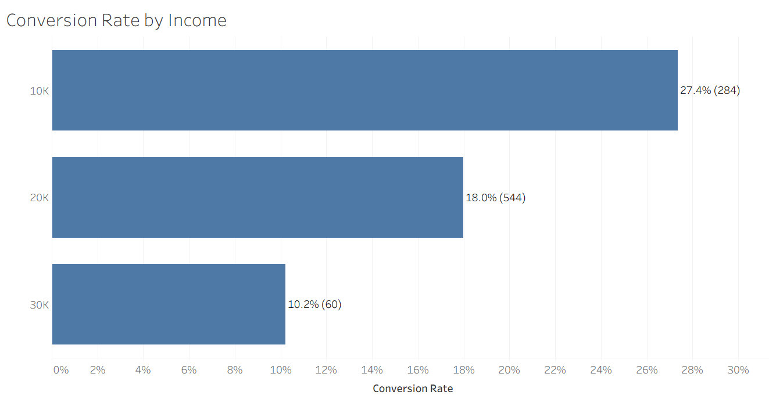
Conversion Rate is Highest Among $10K Income Customers
Customers in the $10K income group have the highest conversion rate at 27.4%, compared with 18.0% for $20K and 10.2% for $30K. Conversion rates decline as income increases.

Slide 8
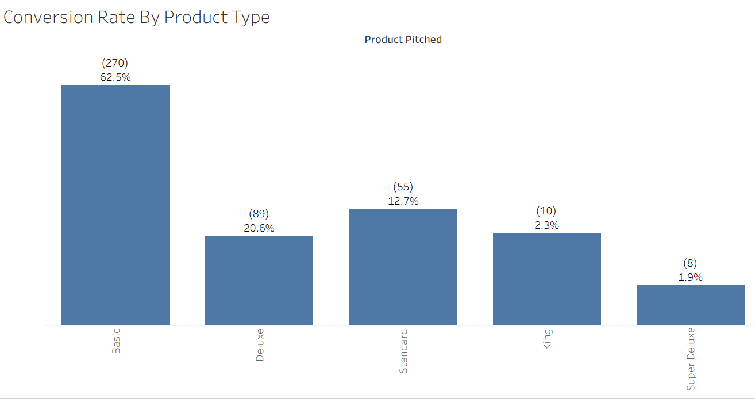
Basic Product Has the highest Conversion Rate
The Basic product has the highest conversion rate at 62.5%, substantially exceeding Deluxe at 20.6% and Standard at 12.7%. King and Super Deluxe have much lower conversion rates of 2.3% and 1.9%, respectively.

Slide 9
Overall Performance KPI Summary
18.8% -Overall Conversion Rate
920 | 3.7 | 4,888 | $23,620
Total Products Taken | Avg. Follow-Ups | Total Customers | Avg. Monthly Income

Slide 10
Key Takeaways
Customer purchase behavior varies meaningfully by contact type, city tier, pitch satisfaction, occupation, and product type.
Recommendations Based on the Analysis
Improve pitch quality by focusing on satisfaction levels associated with higher purchase rates of 21%-22%.
Prioritize the Basic product category while exploring opportunities to improve demand for lower-performing products.
Use occupation and income insights to better target customer segments with stronger conversion potential.

